Slide 1
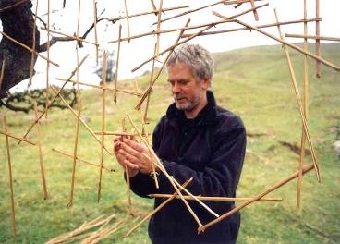
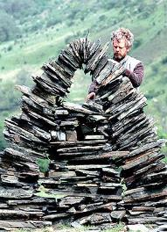
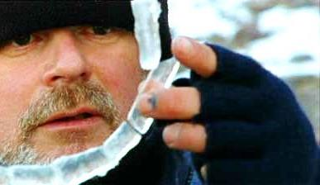
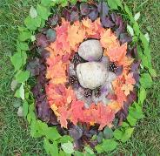
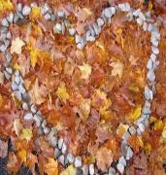
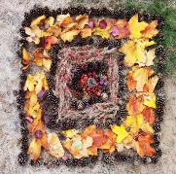
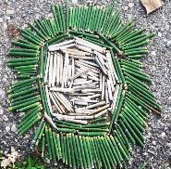
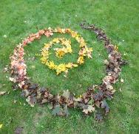
Environmental Art Working outside like Andy Goldsworthy

Slide 2
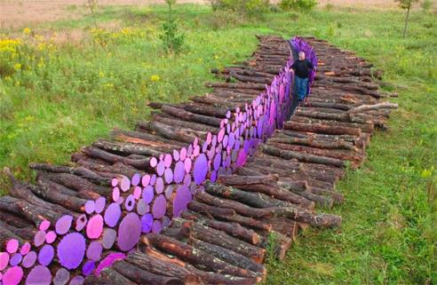
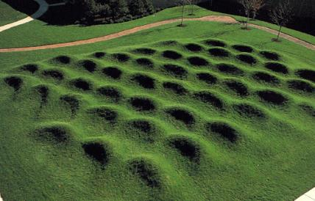
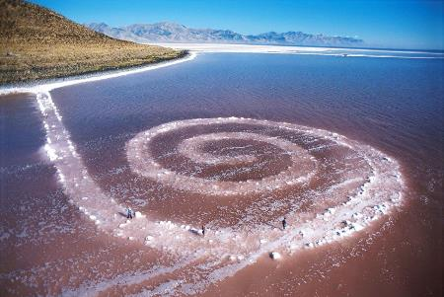
Earthworks- human-made
constructions that modify the land contour.

Slide 3
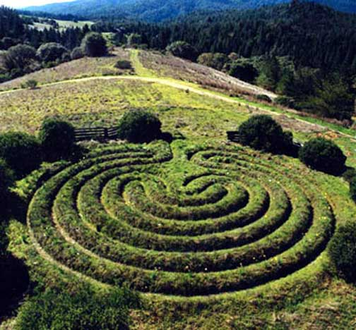
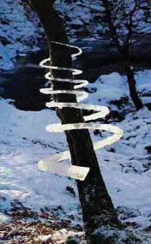
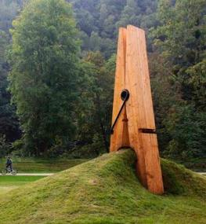
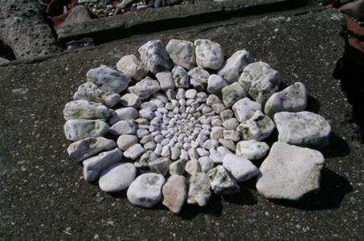

Slide 4
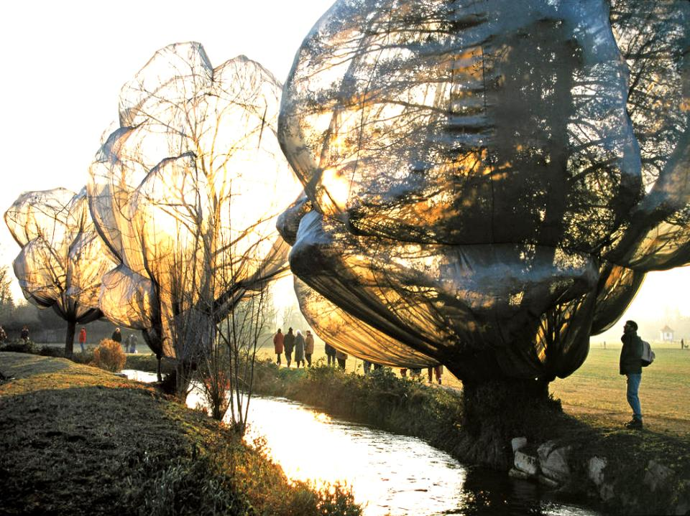
Wrapped Trees
Fondation Beyeler and Berower Park, Riehen, Switzerland 1997-98

Slide 5
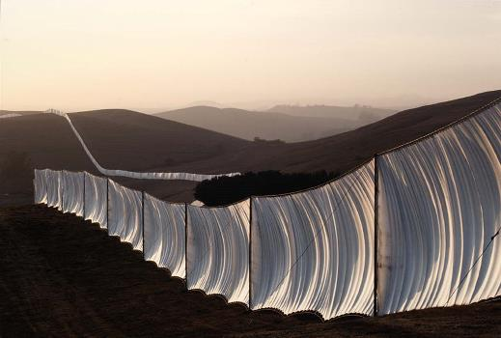
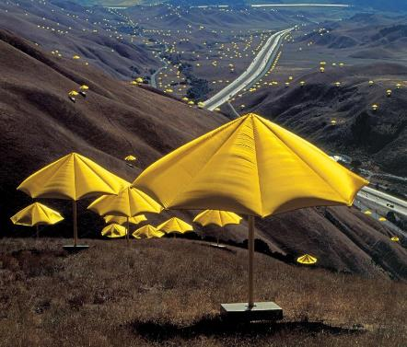
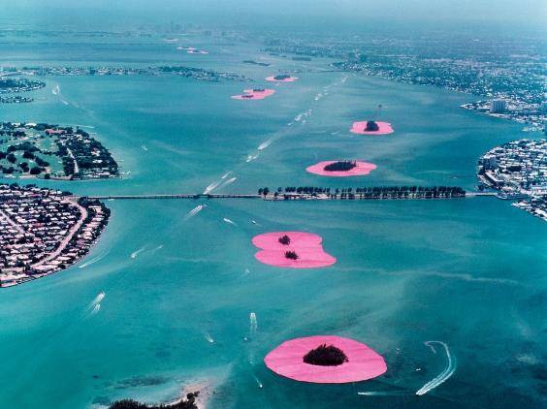
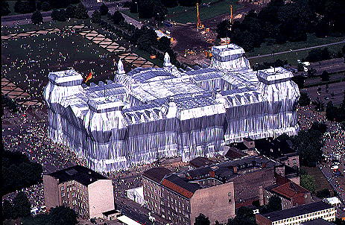
Running Fence 1972-76
Sonoma and Marin Counties, California

Slide 6
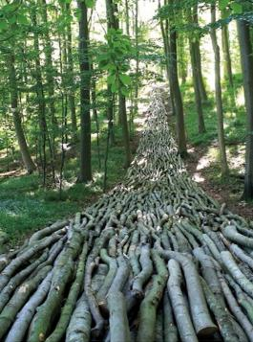
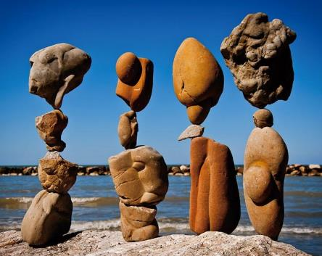
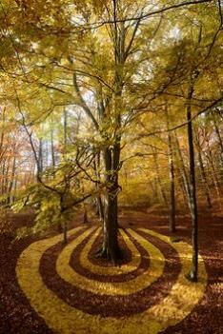
Environmental Art: The production of artistic works intended to enhance or become part of an urban or other outdoor environment.

Slide 7
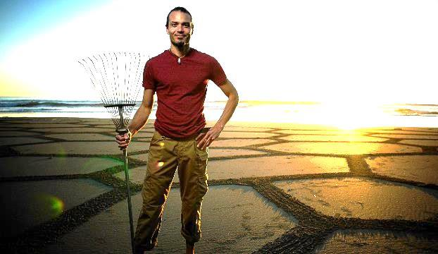
Artist Andres Amador: Sand Art

Slide 8
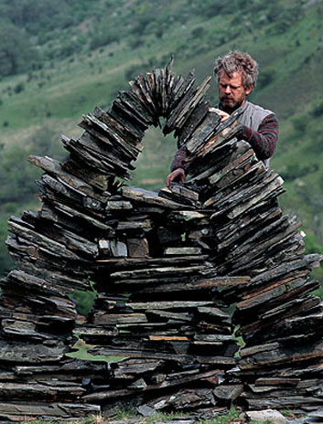
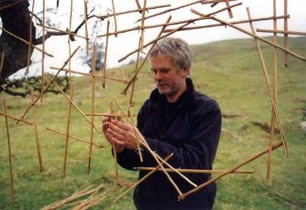
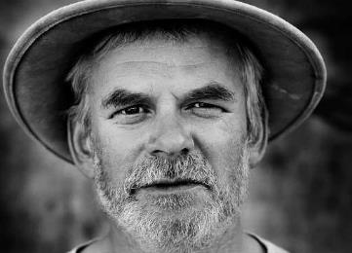
Andy Goldsworthy-
A British sculptor, photographer and
environmentalist producing
site-specific sculpture and land art
situated in natural and urban settings.
"I enjoy the freedom of just using my hands and "found" tools--a sharp stone, the quill of a feather, thorns. I take the opportunities each day offers: if it is snowing, I work with snow, at leaf-fall it will be with leaves; a blown-over tree becomes a source of twigs and branches. I stop at a place or pick up a material because I feel that there is something to be discovered. Here is where I can learn. "

Slide 9
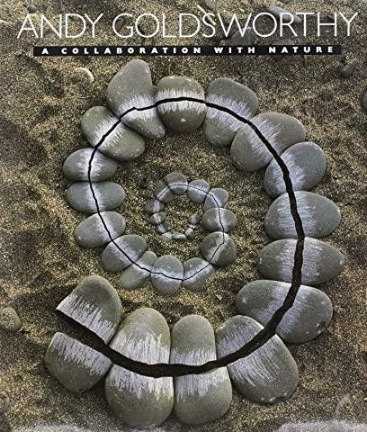

Slide 10
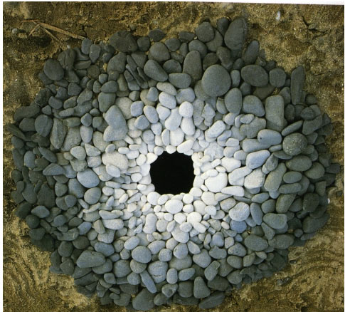

Slide 11
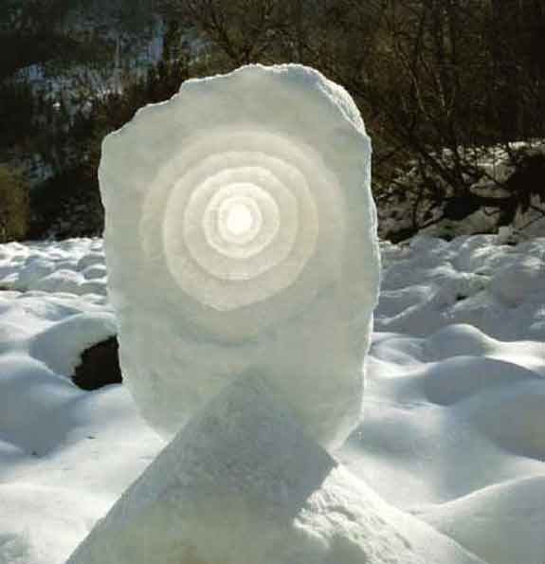

Slide 12
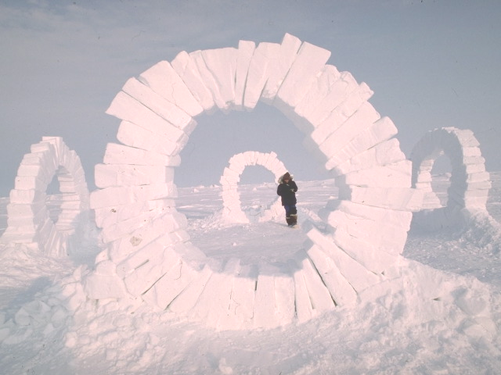

Slide 13
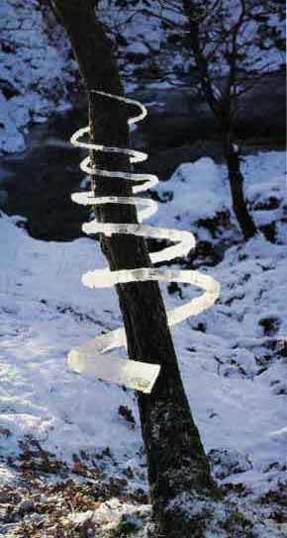
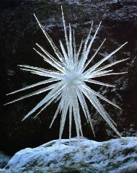

Slide 14
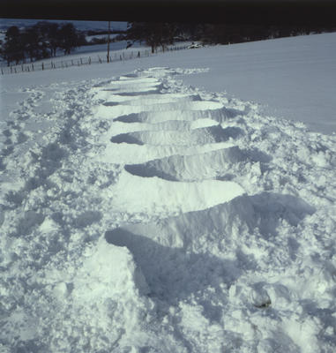
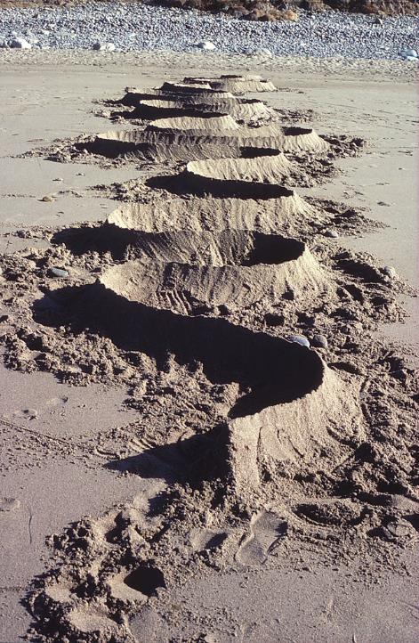

Slide 15
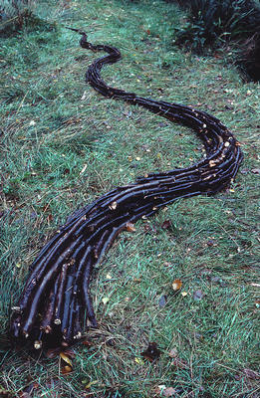
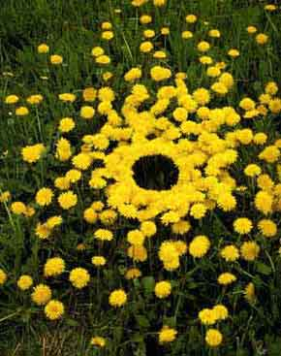

Slide 16
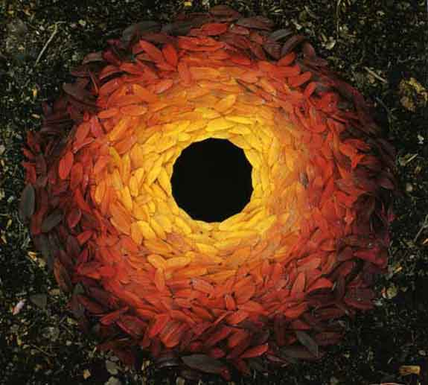

Slide 17
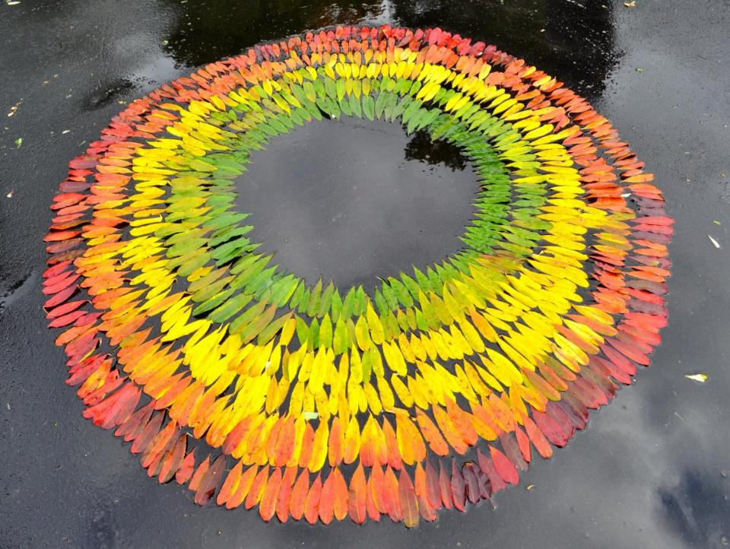

Slide 18
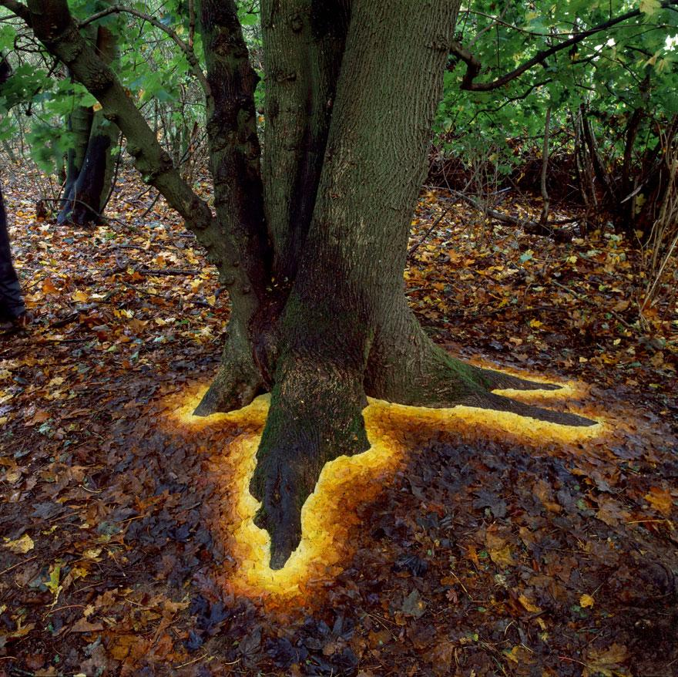

Slide 20
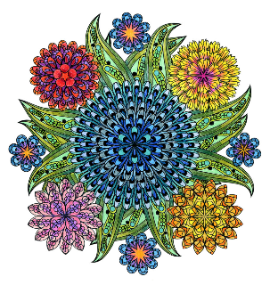
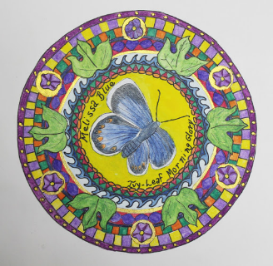
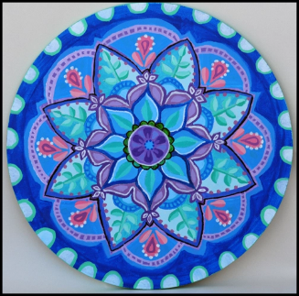
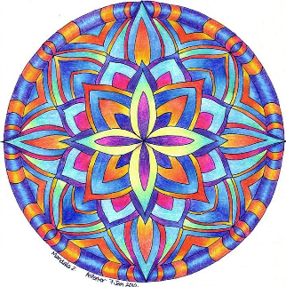
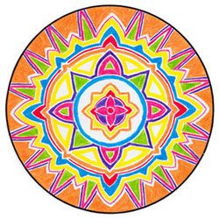
Examples of drawn/painted Mandalas

Slide 21
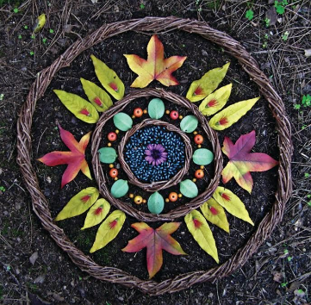
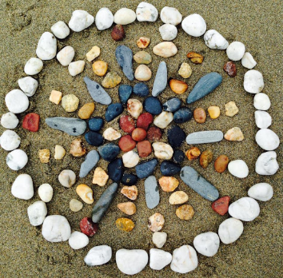
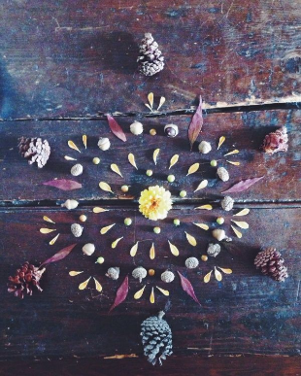
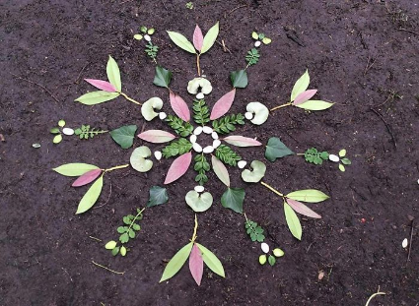
Examples of Environmental Mandalas

Slide 22
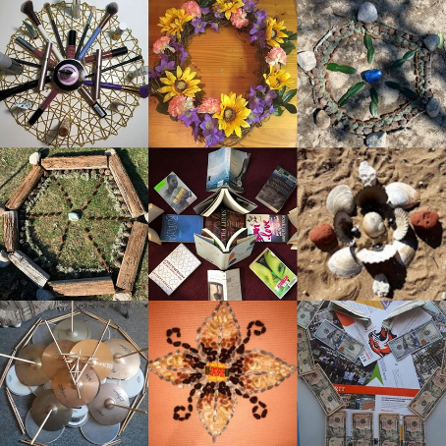
Inside Materials Mandala
-If you can’t go outside or if you don’t have enough natural items to make a mandala, you can choose to create a mandala with items you find around your house.

Slide 23
Look and gather materials found outside!
Look through your materials to think about how to make a mandala (circle with pattern and radial balance).

Slide 27
Environment Art Project Instructions: Creating a Mandala outside
Go outside, get some fresh air, and create some Andy Goldsworthy inspired environmental art!
Gather natural materials (like rocks, sticks, leaves, flowers, etc.).
Try to find items that have different colors, textures, and values.
Be sure to ask before you pick any special garden flowers.
Create a nature mandala - arrange natural objects in a circular pattern that radiates outwards.
Take a picture of your final product from above with the center of the mandala in the center of the picture and/or crop your photo when necessary.
Email or Use Remind App to send the photo to Mrs. Dahl to submit for grading. Include your full name and class-code with email.

Slide 28
Taking a photo of your Art for this project.
Finished Project Photo Requirements-
Watch the “HOW TO TAKE GOOD PICTURES OF YOUR ART” Video.
Stand over your project.
If you are taking pictures indoors, Be sure that there’s really good light in the room. Natural light from the sun is the best. If not, move the art to a well lit room, move it outside, or use the flash.
If you are taking a picture outside, make sure that there are no shadows or sun rays on the art.
Take a VERY CLEAR picture. You might want to take four or five and then pick the best one.
Do not add a filter using a program on your phone to your photo.
Email your photo from your phone or use the Remind App to submit your work to Mrs. Dahl. (Justine.dahl@ccboe.net)

Slide 29
READ The Directions
Reread the directions for this project.
Look over the PowerPoint 1-2 times.
Study the terms
Watch All Videos for this project 1-2 times.
Reread the directions
Before you submit your photo, make sure you have included your full name and class code.
Grading - Project is worth 100 points:
Creativity – 30 pnts
Effort – 20 pnts
Following Directions – 20 pnts
Task Completion – 30 pnts

